Slide 1

Bright Tv Analysis
Executive overview of performance, audience insights, and monetization opportunities.
Presented by Musiiwa Thandabantu

Slide 2
Content
Total Viewing Duration by Age Group
Monthly Viewer Trends
Audience Segmentation by Age Group and Gender
Top 10 Channels by Total Viewing Duration
Audience Reach by Province
Total Viewing Duration by Age Group
Weekly Viewership Engagement Trends
Top 5 Channels for Young Adults(by Engagement)
Conclusion

Slide 3
Introduction
01
Bright TV analysis summarizes recent audience behavior and strategic priorities to drive sustainable growth.
Key objectives:
Assess performance drivers, identify content opportunities and recommend short-term actions to improve engagement and monetization.

Slide 4
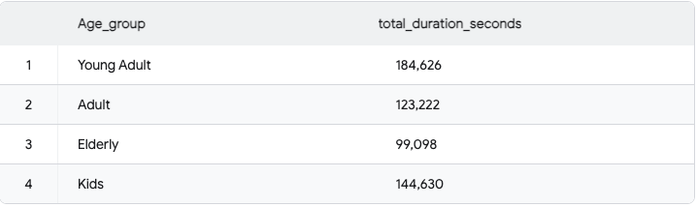
Total Viewing Duration by Age Group
02
The following table and chart show the total viewing duration across different age groups. The duration has been converted to total seconds for easier comparison and visualization.

Slide 5
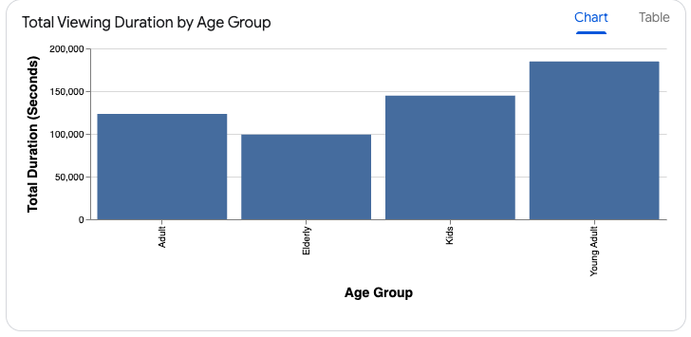
Total Viewing Duration by Age Group
03
The following table and chart show the total viewing duration across different age groups. The duration has been converted to total seconds for easier comparison and visualization.
Insight:
Young Adults are the Most Engaged: The Young Adult group recorded the highest total viewing duration, reaching 184,626 seconds.
High Engagement from Kids: The Kids group followed closely as the second most active audience, with a total duration of 144,630 seconds.
Lower Engagement in Older Segments: Both the Adult and Elderly groups showed lower overall engagement compared to Young Adults and Kids, with the Elderly group having the lowest total duration at 99,098 seconds.

Slide 6
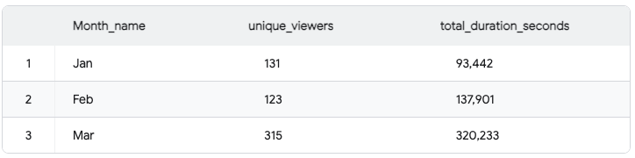
Monthly Viewer Trends
04
The following data and chart represent the monthly trend of unique viewers and their total viewing duration. The analysis shows a significant surge in both viewership and engagement starting in March.

Slide 7
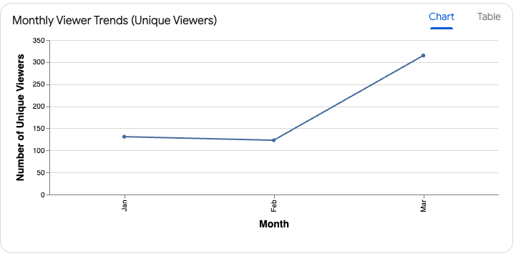
Monthly Viewer Trends
05
The following data and chart represent the monthly trend of unique viewers and their total viewing duration. The analysis shows a significant surge in both viewership and engagement starting in March.
Insight:
Significant Growth in March: There s a substantial increase in viewership during March, with the number of unique viewers growing from 123 in February to 315 in March (an increase of over 150%).
Engagement Growth: Parallel to the viewer count, the total duration also spiked to 320,233 seconds in March, suggesting not only more people were watching but they were also watching for longer periods.
Stable Start: The viewership remained relatively stable between January and February, with a slight dip in the number of unique viewers (from 131 to 123) despite an increase in total viewing duration.

Slide 8
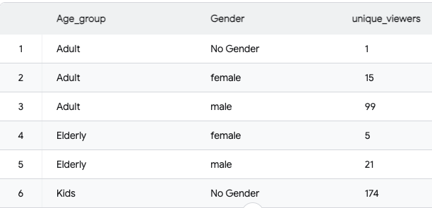
Audience Segmentation by Age Group and Gender
06
The following data and chart represent the audience segmentation by age group and gender. This provides a clear picture of the demographic makeup of your viewers.

Slide 9
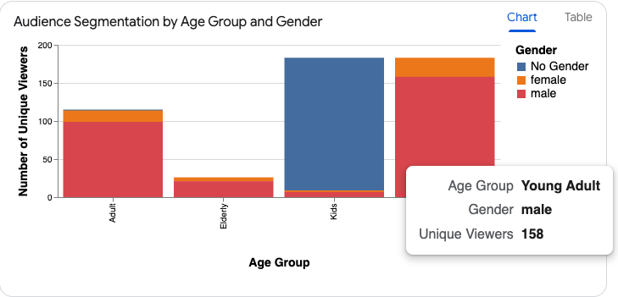
Audience Segmentation by Age Group and Gender
07
The following data and chart represent the audience segmentation by age group and gender. This provides a clear picture of the demographic makeup of your viewers.
Insights
High Presence of "No Gender" in Kids: The largest single segment consists of 174 unique viewers in the "Kids" age group with "No Gender" assigned. This likely reflects accounts where gender data for children was not captured or is intentionally kept private.
Young Adult Males lead identified segments: Among audiences with a specified gender, Young Adult males (158 viewers) are the most prominent group, followed by Adult males (99 viewers).

Slide 10
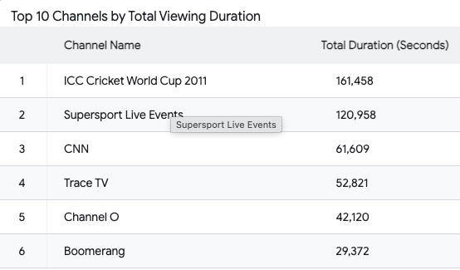
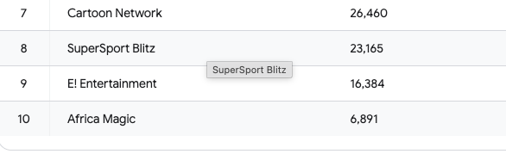
08
Top 10 Channels by Total Viewing Duration
This analysis presents a comprehensive overview of viewership trends, highlighting top-performing content, key audience demographics, regional reach, and weekly engagement patterns.

Slide 11
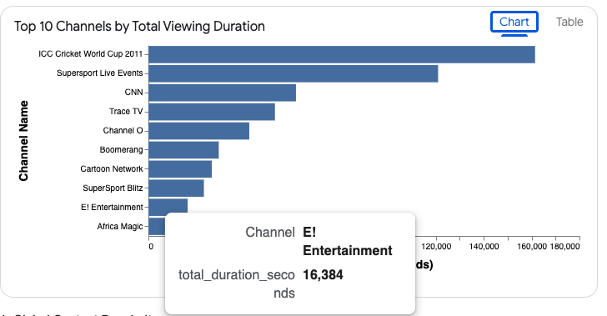
09
Top 10 Channels by Total Viewing Duration
This analysis presents a comprehensive overview of viewership trends, highlighting top-performing content, key audience demographics, regional reach, and weekly engagement patterns.
Insights:
The ICC Cricket World Cup 2011 and Supersport Live Events dominate the viewing charts, indicating a strong preference for live sports content among the general audience. CNN and Trace TV follow as the top non-sports channels.

Slide 12
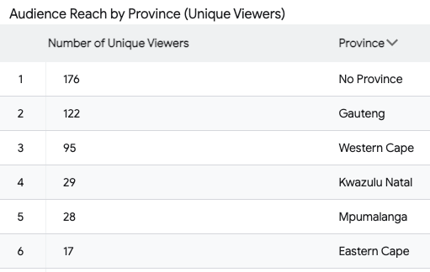
Audience Reach by Province
10
The ICC Cricket World Cup 2011 and Supersport Live Events dominate the viewing charts, indicating a strong preference for live sports content among the general audience. CNN and Trace TV follow as the top non-sports channels.

Slide 13
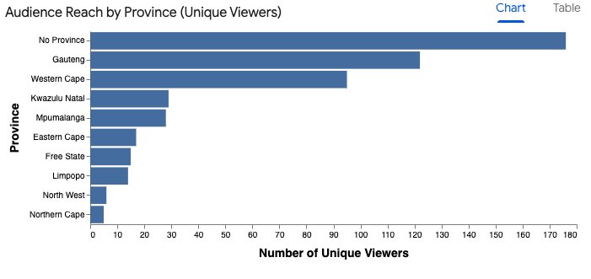
Audience Reach by Province
11
The ICC Cricket World Cup 2011 and Supersport Live Events dominate the viewing charts, indicating a strong preference for live sports content among the general audience. CNN and Trace TV follow as the top non-sports channels.
Insight:
Gauteng and Western Cape are the primary hubs for unique viewers. This concentration in urban provinces highlights the core geographic market for broadcasters.

Slide 14
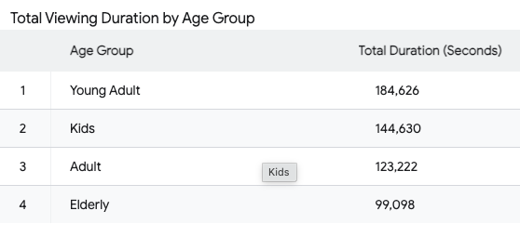
Total Viewing Duration by Age Group
12
The following table and chart show total viewing duration broken down by age group.

Slide 15
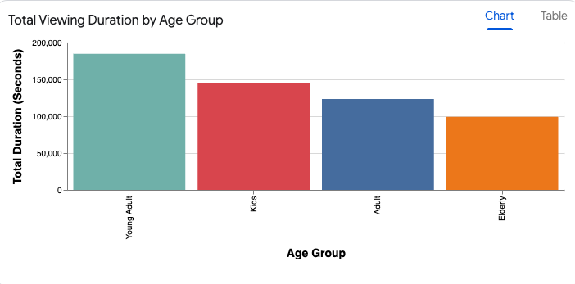
Total Viewing Duration by Age Group
13
The following table and chart show total viewing duration broken down by age group.
Insight:
Young Adults are the most engaged segment by total duration, followed closely by Kids.
This demonstrates that while sports (likely driven by adults) are popular, youth-oriented programming and cartoons also command significant viewing time.

Slide 16
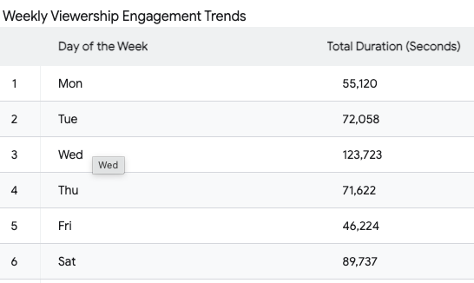
Weekly Viewership Engagement Trends
14
The following table and chart illustrate the engagement trends for each day of the week.

Slide 17
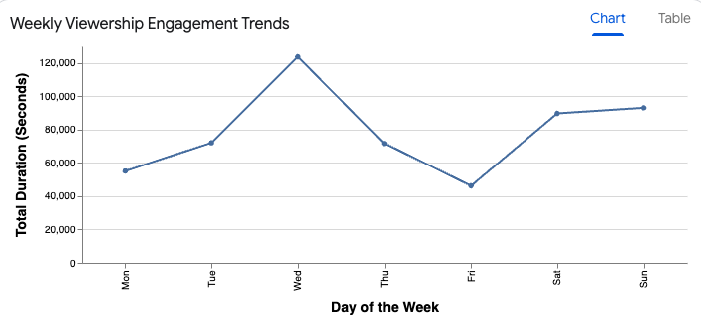
15
Weekly Viewership Engagement Trends
The following table and chart illustrate the engagement trends for each day of the week.
Insight:
Engagement peaks significantly on Wednesdays and remains high during the weekend (Saturday and Sunday). The midweek spike suggests an opportunity for high-impact programming or ad placement.

Slide 18
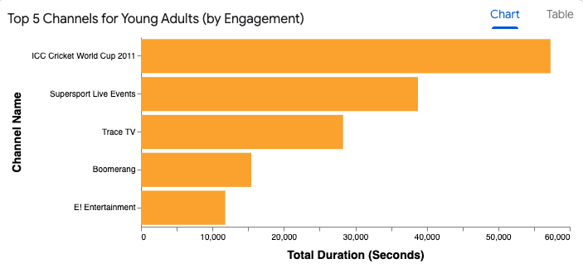
Top 5 Channels for Young Adults(by Engagement)
16
The following table and chart focus on the top 5 channels preferred by the "Young Adult" age group.
Insight:
While sports remain popular with Young Adults, there is also a notable interest in music and entertainment via channels like Trace TV and E! Entertainment.

Slide 19
Conclusions
The analysis reveals a broadcasting landscape dominated by high-impact sports content and a rapidly growing audience base, particularly among younger demographics in urban hubs.
1. Core Content Strategy: Sports vs. Entertainment
Sports Supremacy: Live sporting events, specifically the ICC Cricket World Cup 2011 and Supersport Live Events are the primary drivers of viewing duration across all demographics.
Diversified Entertainment: While sports lead, there is a strong secondary market for music (Trace TV, Channel O) and international news (CNN), providing consistent alternative engagement.
2. Key Audience Demographics
The Youth Engine: Young Adults and Kids represent the most engaged segments. Young Adult males are the most active identified group, while the Kids segment shows high volume, often with unassigned gender data.
Gender Gap: There is a significant gender imbalance in identified segments, with male viewers substantially outnumbering females in Adult and Young Adult categories.
3. Temporal and Regional Trends
March Growth Spike: Unique viewership increased by approximately 150% in March compared to February, indicating strong event-driven or seasonal demand.
Peak Viewing Patterns: Engagement peaks midweek on Wednesdays and remains consistently high over weekends.
4. Strategic Insights and Opportunities
Content Optimization: Prioritize live sports broadcasting while expanding youth-focused entertainment to maintain engagement beyond major events.
Audience Diversification: Develop targeted strategies to increase female viewership, particularly within entertainment and educational content segments.

